Slide 1


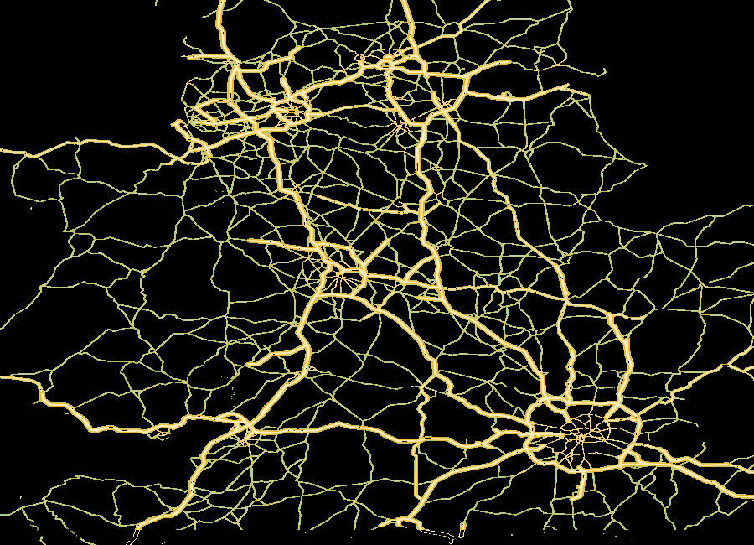
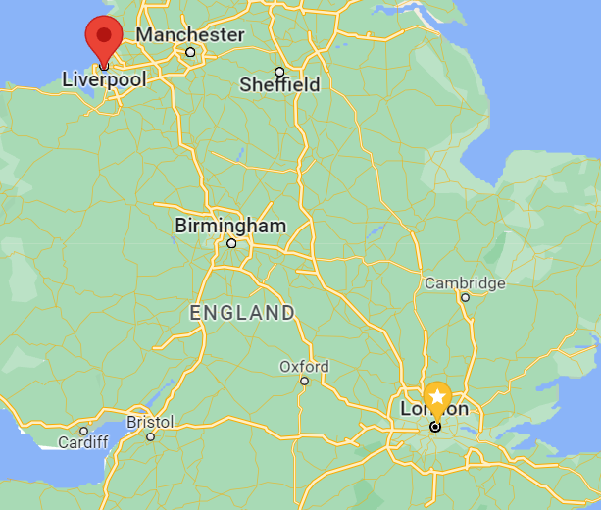
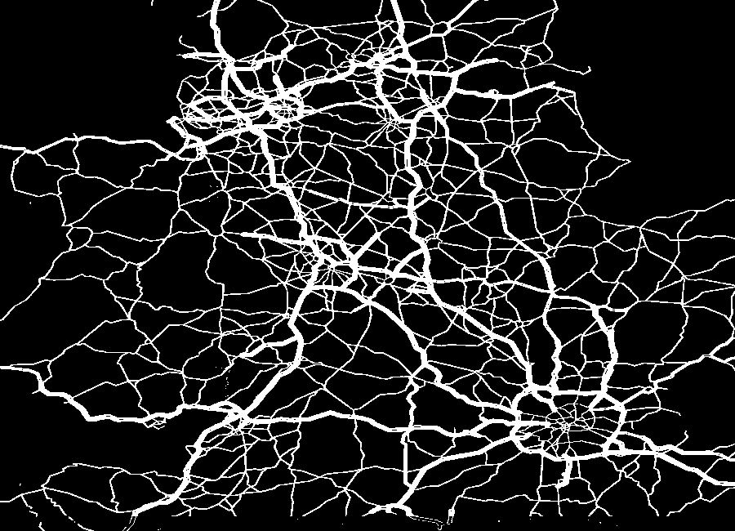
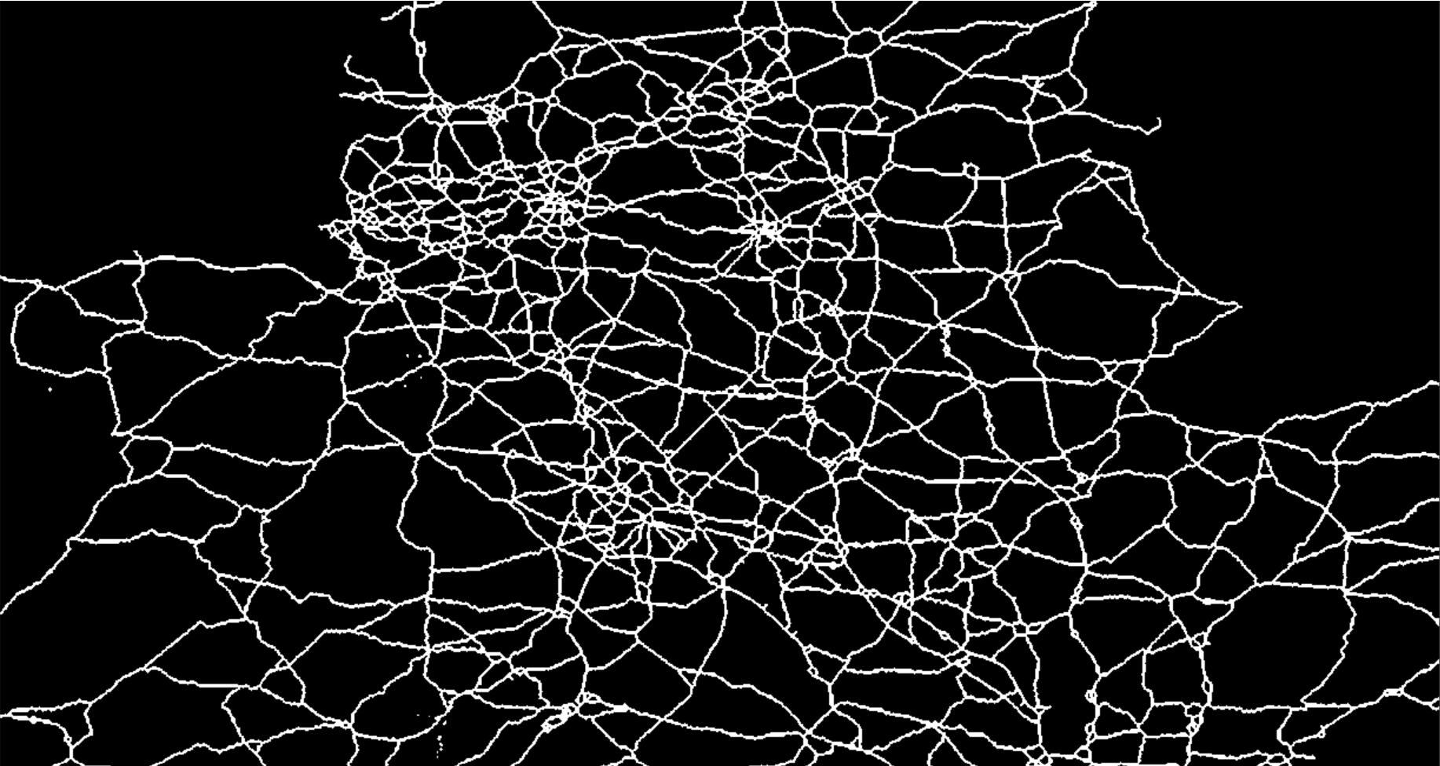
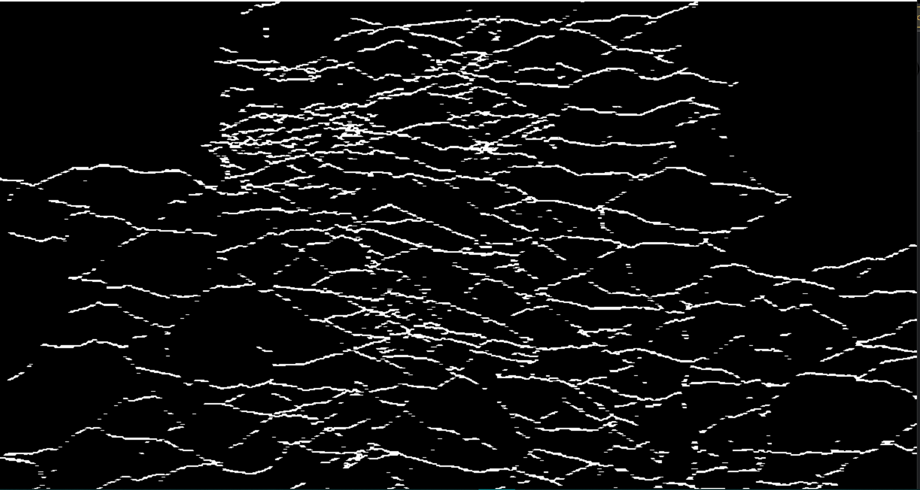
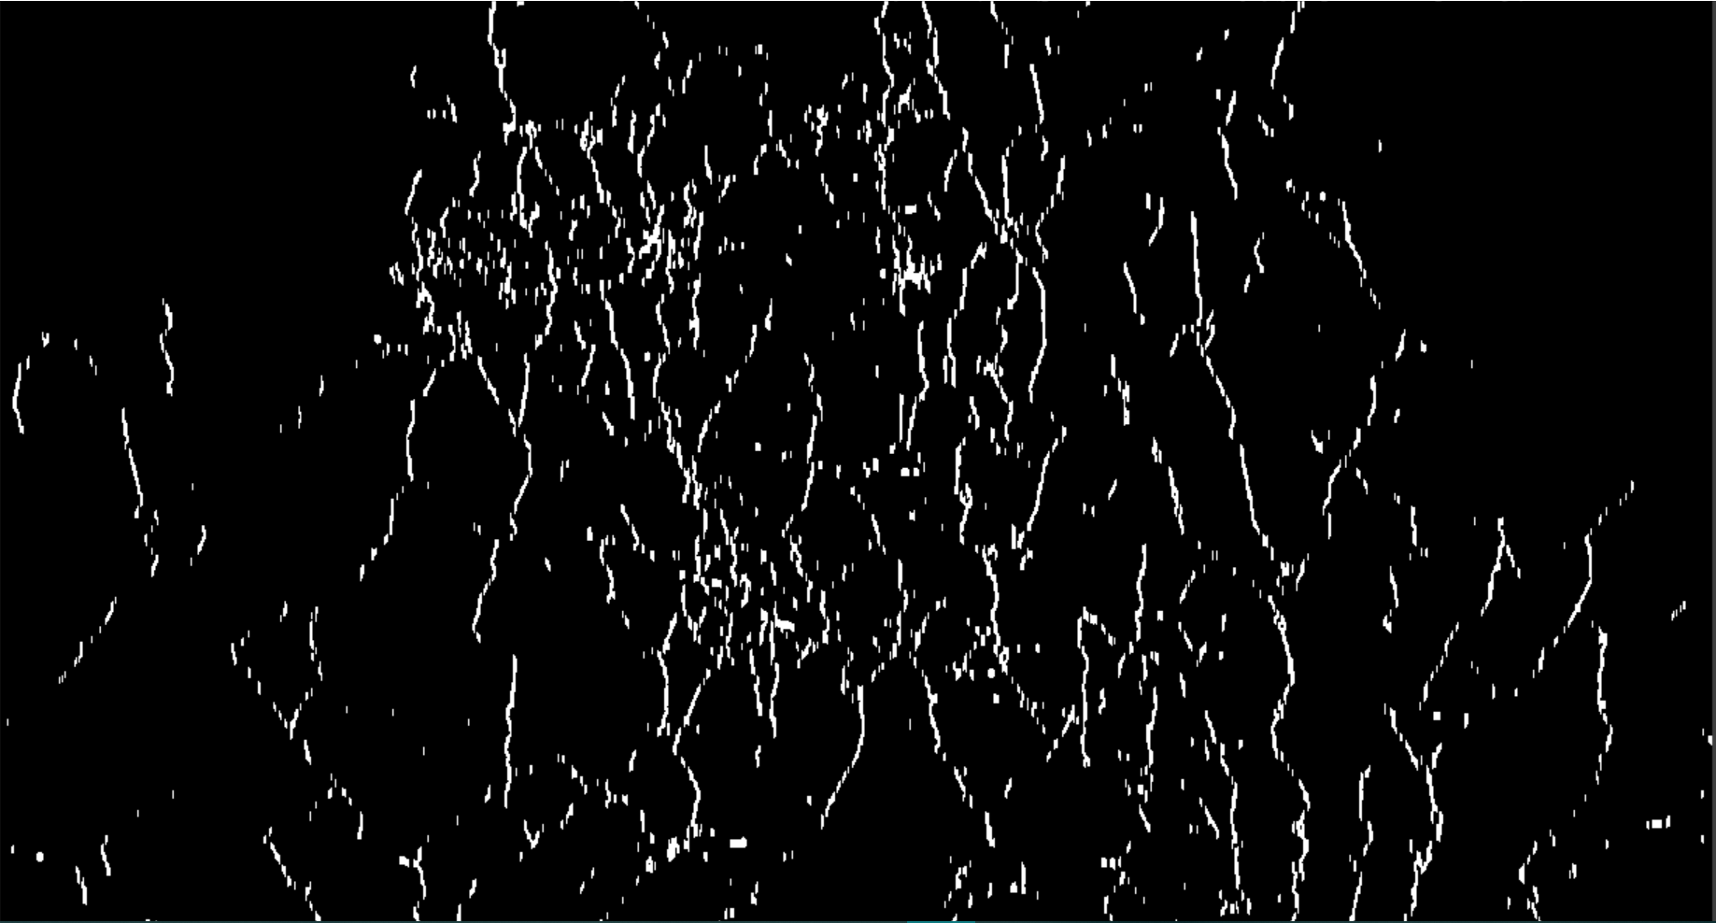
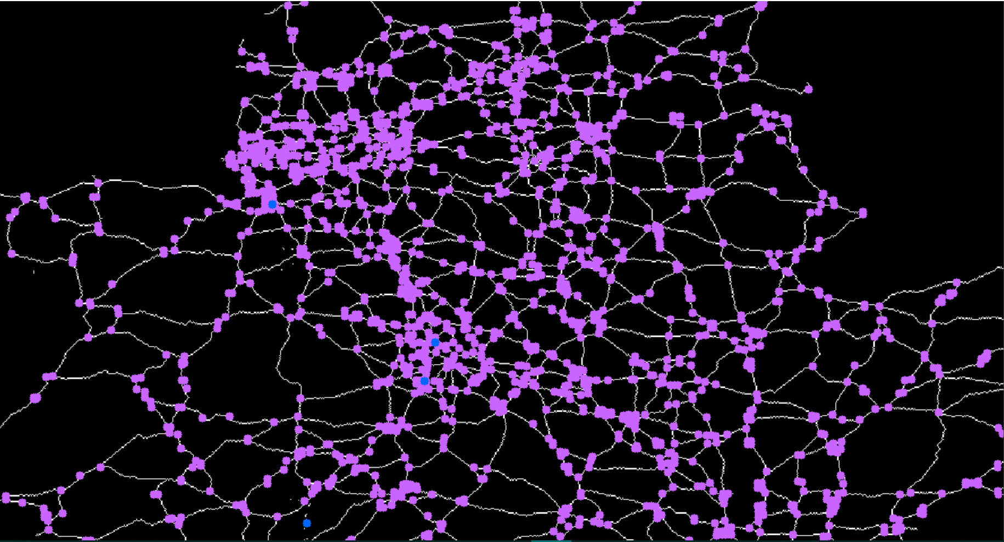
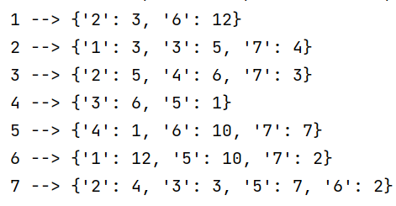
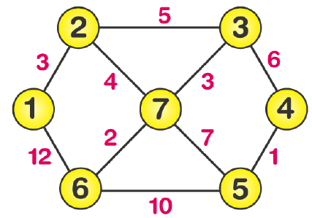
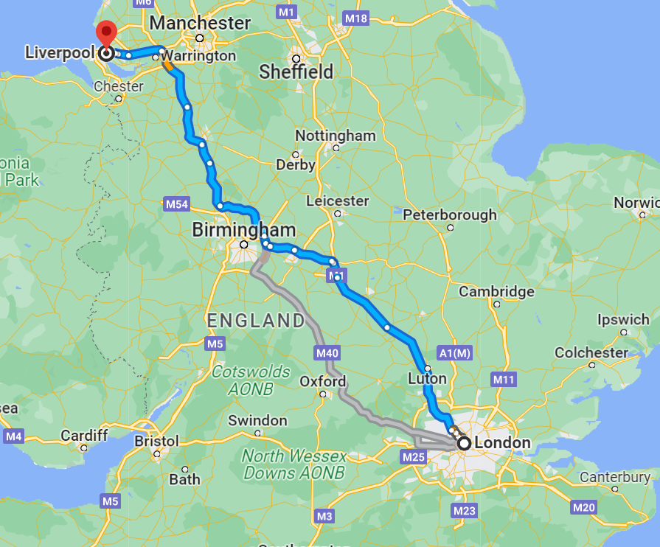





The Pathfinding Visualiser
Student: Emmanuel Olaoye Supervisor: Themistoklis Melissourgos
User enters start and destination
Introduction
This project is project aims a computer vison tool that automatically reads the roads on a map to deliver the shortest path between two user entered destinations
User enters start and destination
The road is masked out and converted in to a binary image
image is thinned into a 1-pixel-wide skeleton
Image is polarized into horizontal and vertical lines………
To form a neighborhood representation
To find the road intersections
To run Dijkstra's algorithm
To find the shortest path

